Slide 1
NETCD Project 2
Rui Bin, Jia Yi, Joanna s10169526, s10179524, s10163218 PE21
Notes:
Jo

Slide 2

Our Cloud Service
Notes:
Jo
What is Microsoft Azure?
cloud computing service provided by Microsoft
Similar to AWS which all of us have used before
Provides resources such as VMs, databases and shared folders

Slide 3
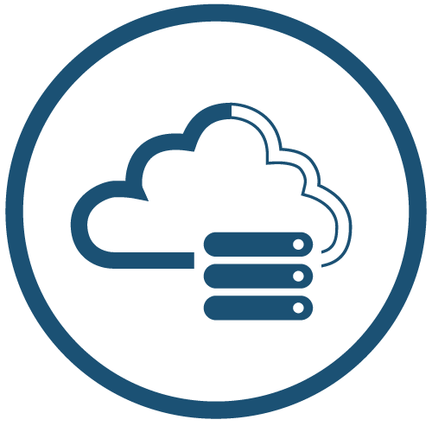
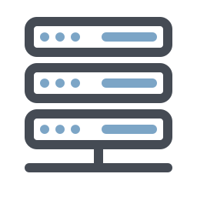
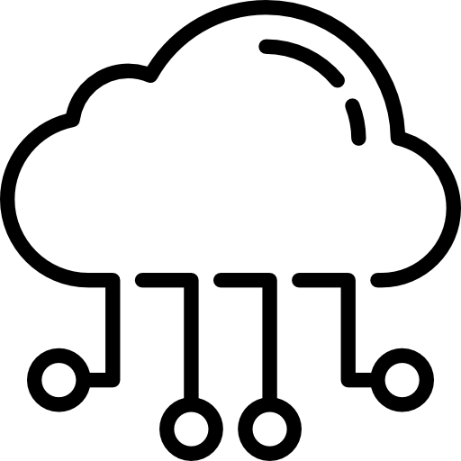
Pull Factors
$
Cheaper
Dynamic Allocation of Resources
Resource Sharing
IaaS
Notes:
Jo
We already had 90 credits for Azure so it was immediately cheaper than using AWS
Wanted to use Raspberry Pi but it was not able to handle the load of the server - Dynamic Allocation of resources
Buying a new physical server will also take time - hence using Cloud COmputing is more efficient
Hence by using Azure, we need not sorry about the infrastructure restrictions (?)
Resource sharing via Azure : everyone has access to the resource (vs 1 local RaspPi)
IaaS - We chose this service model as it is the most suitable for this project - whereby we have to manage/use a cloud service

Slide 4
SaaS on IaaS
Azure to provision infrastructure where we create our VMs on
Install and manage using Ansible and Terraform
Install NextCloud within the VM
Utilise Docker to set up
Docker is not PaaS
Notes:
Jo

Slide 5
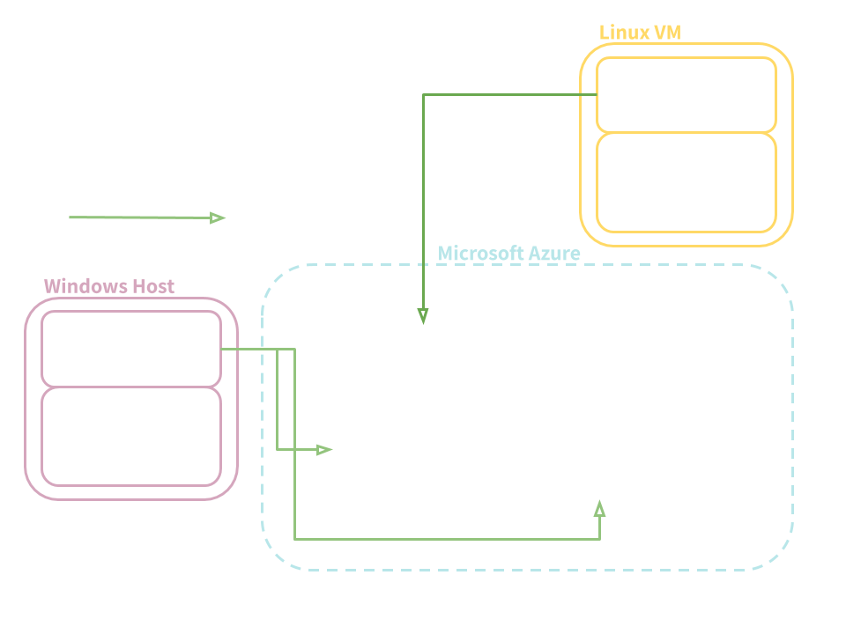
Our Cloud Diagram
Notes:
Jo
Ansible can only be run on a Linux OS, hence we used ubuntu

Slide 6
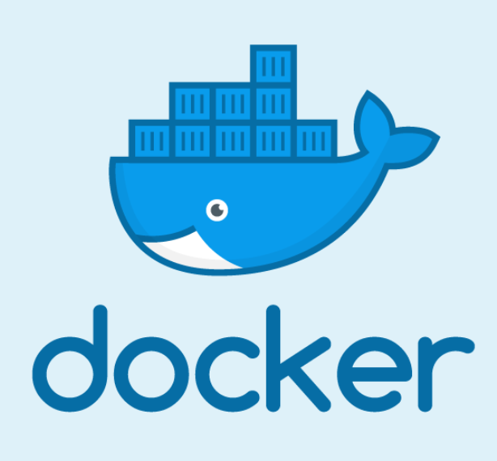
Docker 🐋
Runs software packaged in container images
Containers are isolated from one another and communication between each container is managed by Docker
Portability: Bring containers to any other machines with Docker
Notes:
Jo

Slide 7
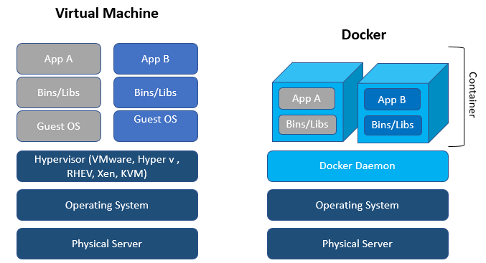
Notes:
Jo
Traditionally, in a VM, an application would run on the OS
With Docker, the application and it’s relevant dependencies can be containerised
Hence the application will think that it’s running on its own OS, but it is actually running on the host’s OS
This allows developers to send containers containing applications that can run, but only on the similar OS that it came from (aka ubuntu on redhat, or windows on windows)
Extra
Your can choose which port you want a container to be port-forwarded on
Also, you can choose if you want multiple containers to be present on the same virtual network
Containers are isolated from each other by default
Container isolation = administrator does not need to handle as many configurations (e.g network config) as it will be handled by Docker
Docker is not a PaaS
Rather it is a platform that helps with the setup of PaaS
Why containers instead of VMs? → container images are smallers, no need a guest OS
Also usually if you directly install the application on the VM itself, we have to ensure that the application and VM can run with each other
Whereas via containers, each application has it’s own “Virtual Network” and it able to run on its own

Slide 8

NextCloud
SaaS
For creating and using file hosting services
Highly extensible through apps
Free & Open-Source
Notes:
Jo

Slide 9

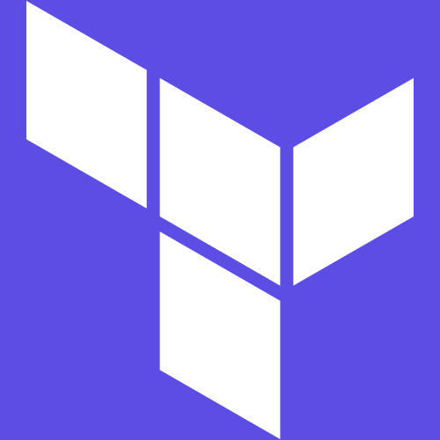
Terraform & Ansible
Automation
Infrastructure as code
Configuration management
Desired state
Reproducible
Notes:
JY
Automation - Automatically creates / updates / destroy cloud resources
Infrastructure as code - write code to define how the infrastructure is going to be like
Config management - Keep track of config so that we know what we have applied
Desired state - Declare end state, Ansible and Terraform helps you get there
Reproducible - will always get the same end state

Slide 10

Terraform
Automation for the setup and configuration of VMs and cloud resources (Storage, etc)
Easy setup and teardown environment through code
Dynamic allocation of resources
Notes:
JY

Slide 11
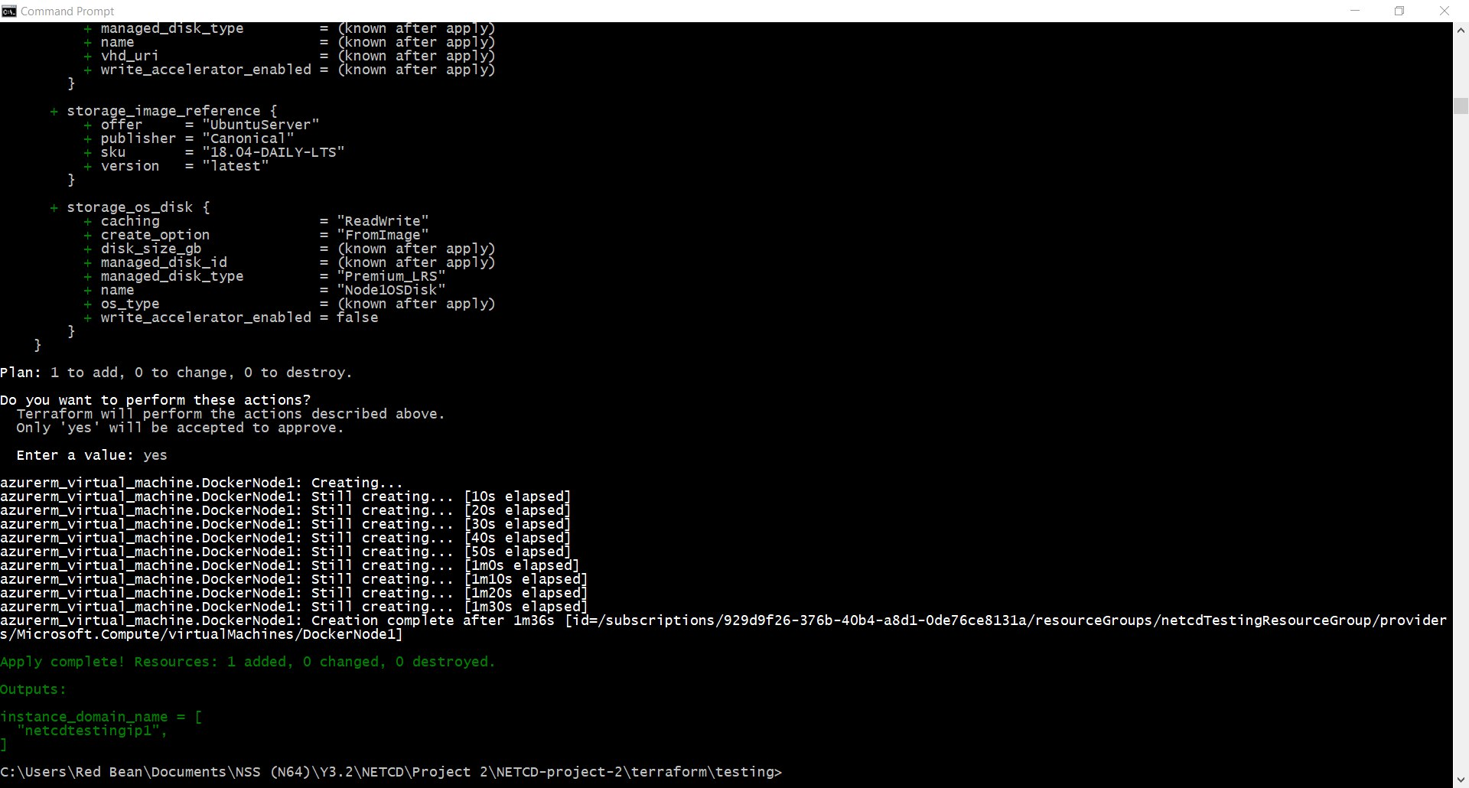
Terraform
Notes:
JY
This was fixing a deployment. Initial deployment failed. In this second deployment the other resources created are not changed, Terraform only creates what are missing

Slide 12

Ansible
Runs on Linux
Agentless, use SSH or WinRM to manage
Configuration management tool
Automates applications and packages installation
Easily rebuilds config
Notes:
JY
Run on linux - only runs on linux
Agentless - no need to specially config server
Configuration man - keep track of what config is used

Slide 13
Ansible - Configuring Docker
Notes:
JY

Slide 14
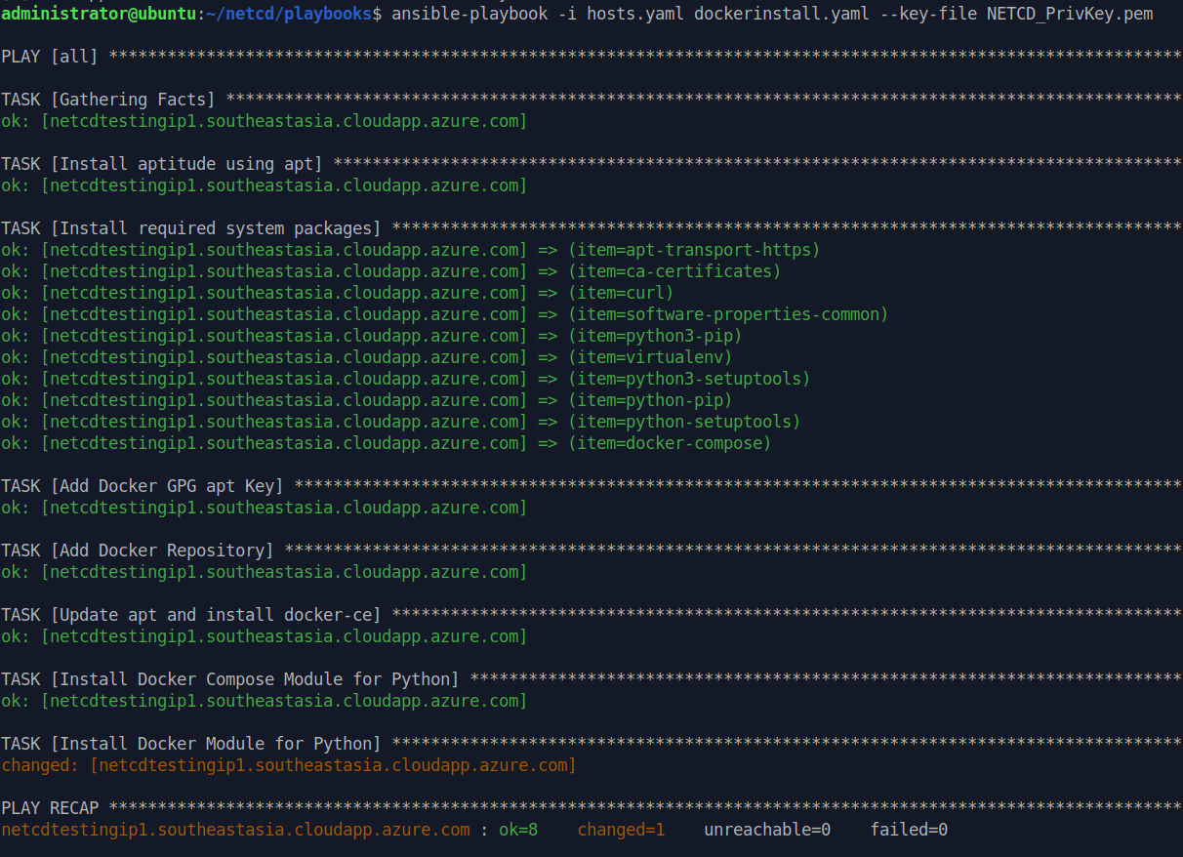
Notes:
JY

Slide 15
Ansible - Configuring NextCloud
Notes:
JY

Slide 16
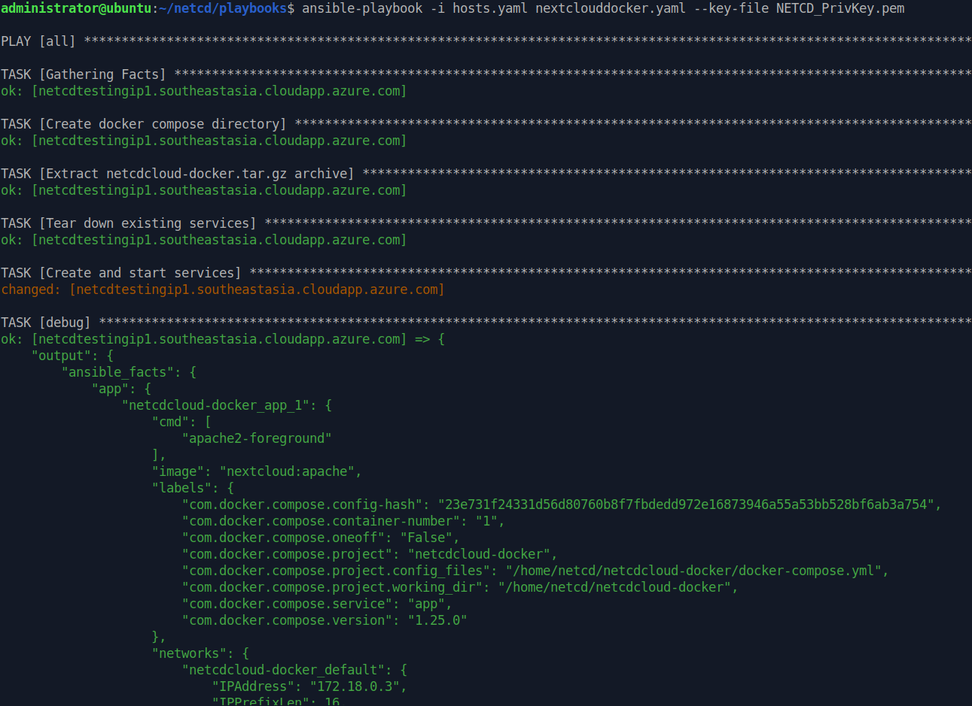
Notes:
JY

Slide 17
Terraform - Config snippet
Notes:
JY

Slide 18
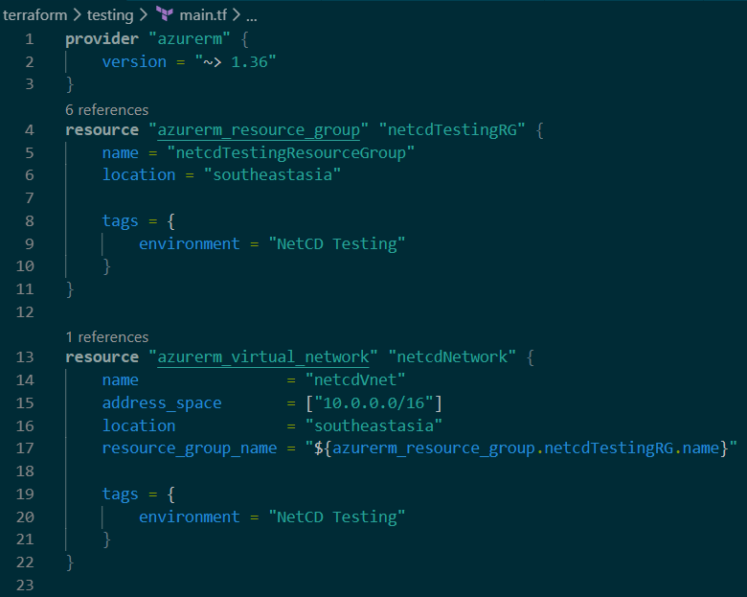
Notes:
JY

Slide 19
Ansible - Playbook snippet
Notes:
JY

Slide 20
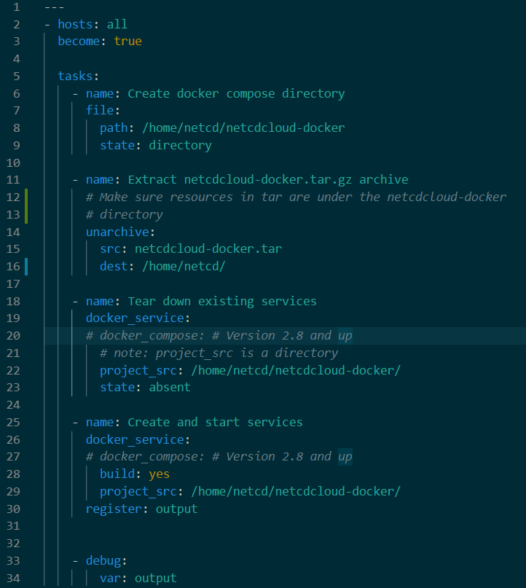

Notes:
JY

Slide 21
Source Control Git
Keep track of config changes
I.e. Commit history
Easily revert breaking changes
Store code in same place as application source code
Notes:
RB

Slide 22
GitHub - Commit history
Notes:
RB

Slide 23
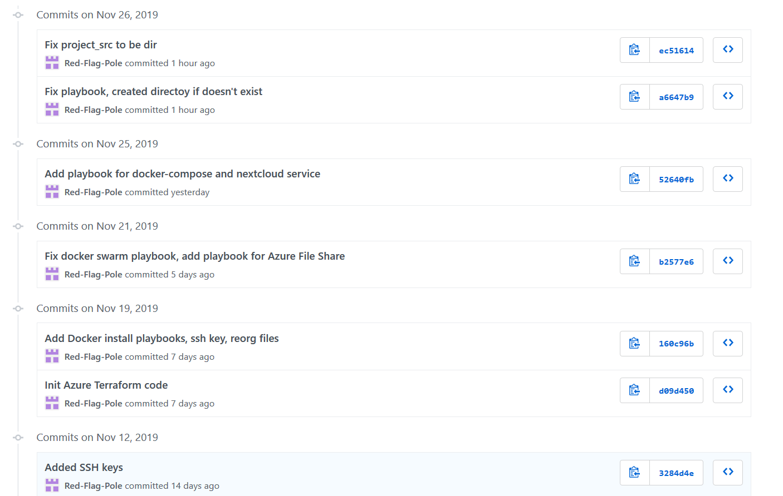
Notes:
RB

Slide 24
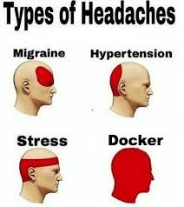
Challenges we faced
Attempts to create hybrid cloud failed as the local server (Raspberry Pi) ran out of RAM
Attempted to create multi-cloud using AWS RDS but was unable to connect to the Database
Wanted to use Azure Blob Storage but NextCloud could not connect directly
Wanted to use a cheaper VM size but it was not available without contacting Microsoft
Notes:
RB

Slide 25
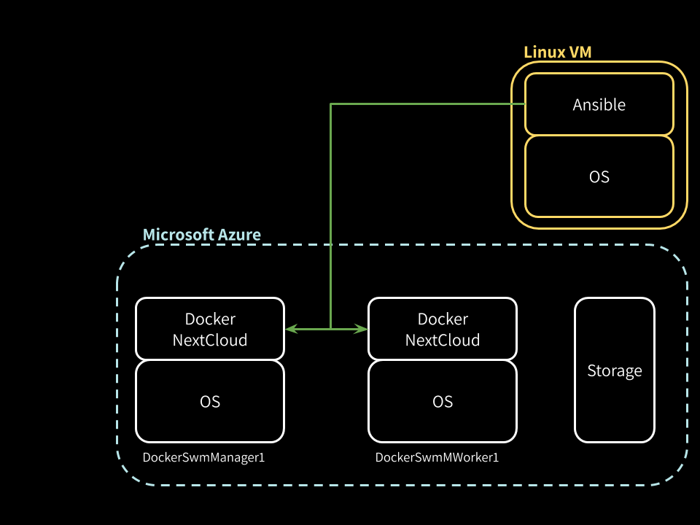
Our Cloud Diagram (Enhancement)
Notes:
RB
Explanation on why we did not continue with DockerSwarm (Scalability + Load Balancing)
→ Not enough time, will leave it as an option for enhancement.

Slide 26
Demonstration
Notes:
RB

Slide 27
Thank You
Notes:
RB

